Slide 1
CRAFTING CUSTOM CHATBOTS
Presented by: Hamza Bouzoubaa and Omar Ouadouha
Subtitle or speaker name

Slide 2

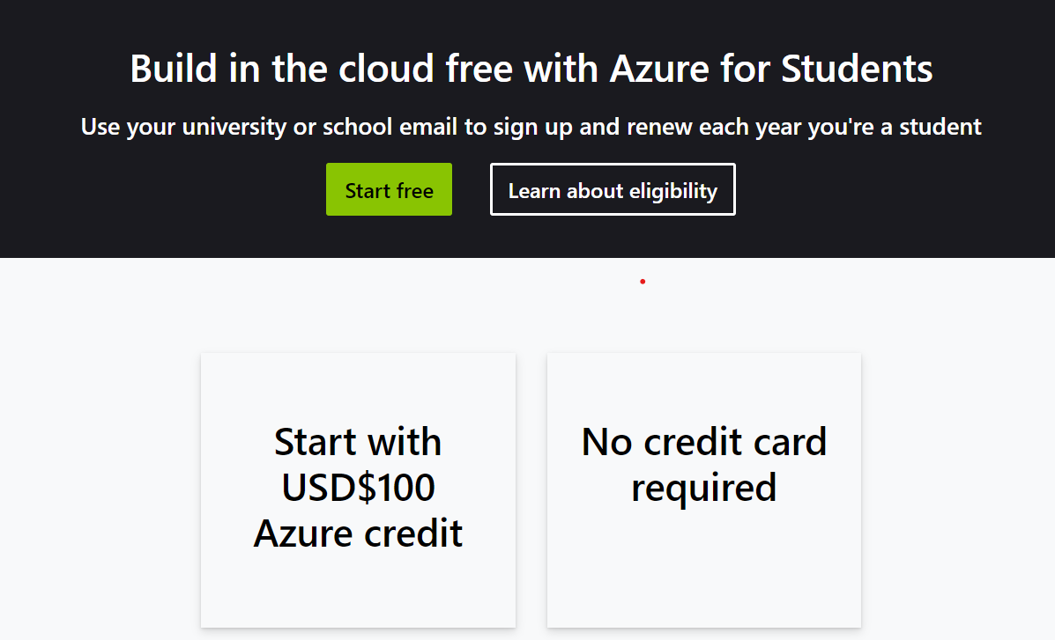
Before we start
Python installed
Azure set up

Slide 3
Today's plan
What is AI?
What is ChatGPT?
How to give knowledge to Large Language Models?
Intro to RAG
What are vector databases?
LLM + RAG + Vector Databases
Live coding Workshop

Slide 4
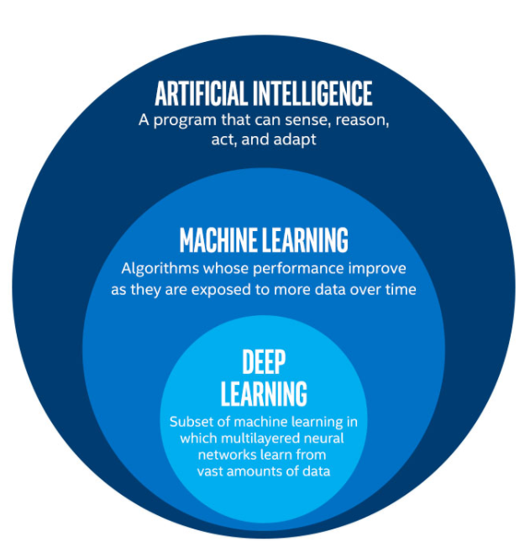
AI vs Machine learning vs Deep learning

Slide 5

Popular machine learning technics
Supervised learning
Unsupervised learning
Semi-supervised learning
Reinforcement learning

Slide 6
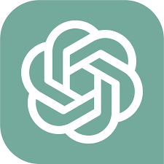
What is ChatGPT
GPT: Generative Pre-trained Transformer
Transformer
Listening to Everything
Attention mechanisms
Remembering and Using the Context
Generating Text

Slide 7
How to give knowledge to an LLM
Finetuning
Ressource Augmented Generation
Pros:
Custom Behavior
Task-specific Performance
Ex: Talk like a salesman
Cons:
Risk of Hallucination
Not Ideal for Rapidly Changing Data
Time and Resource Intensive
Pros:
Reduces Hallucination
Adaptable to rapidly changing data
Ex: Knowledge of course data
Cons:
Requires Specific Data
Limited Behavior Modification
Slower answering time

Slide 8
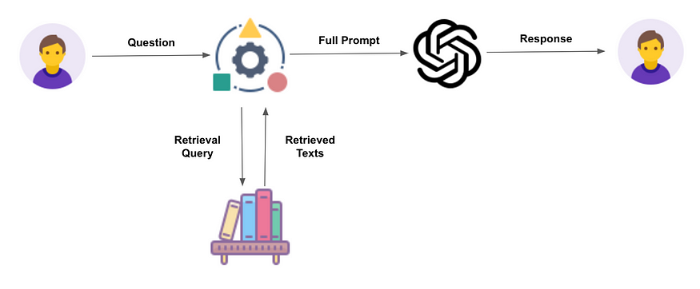
What is RAG?
Retrieval Augmented Generation (RAG) is a technique used to enhance the performance of large language models by retrieving relevant information from a specific context or data source to generate responses.

Slide 9
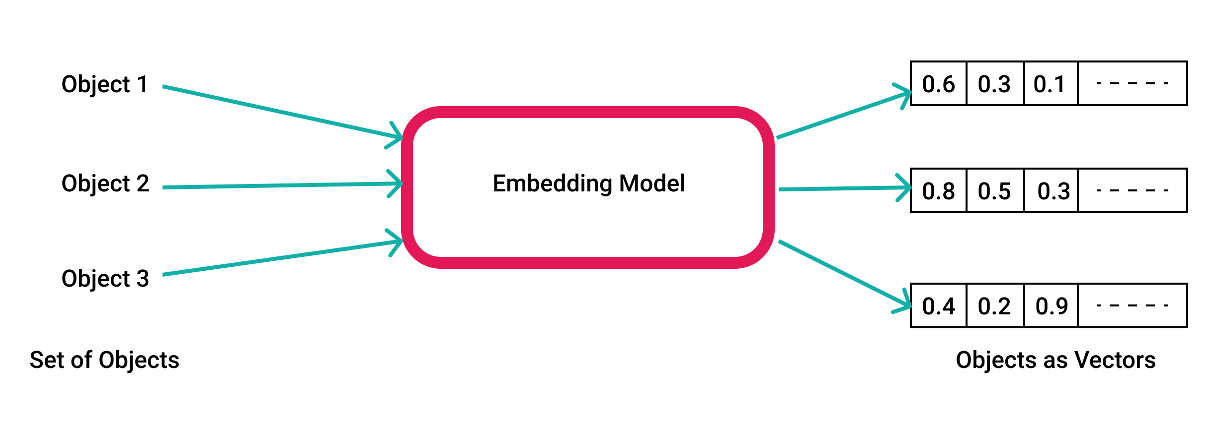
What are embeddings?
Vector embeddings are numerical representations that capture and quantify the similarities between objects like words, images, or sounds for machine learning tasks.

Slide 10
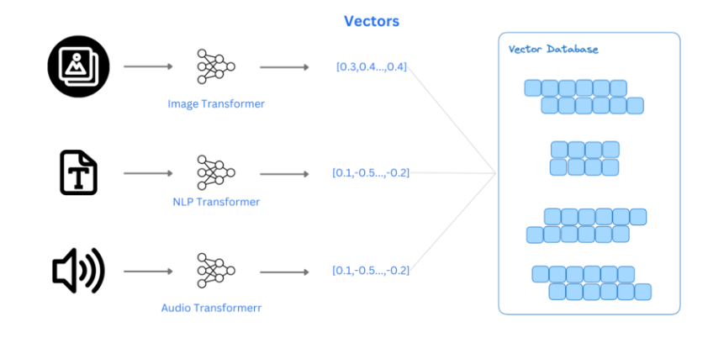
What are vector database?
Vector Databases are used to store and retrieve vectors effectively

Slide 11
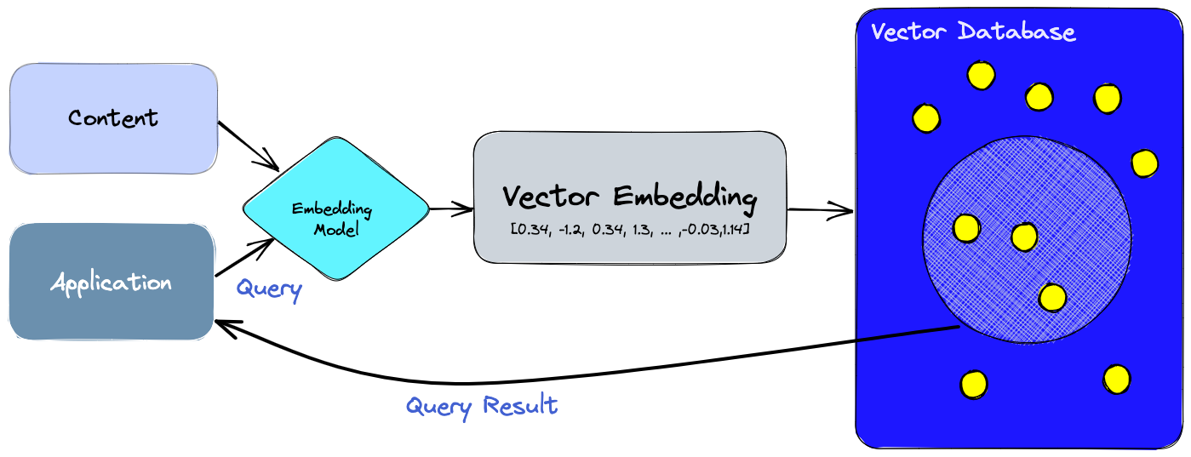
RAG + Vector Databases

Slide 12
Live coding

Slide 13
Thank you!!
How become a Microsoft student ambassador?
You need to apply here:
https://mvp.microsoft.com/studentambassadors/apply
Advantages :
Access to Azure tools (210 $ per month)
Linkedin learning for free
Networking opportunities
Student developers community
SWAG!!

Slide 14

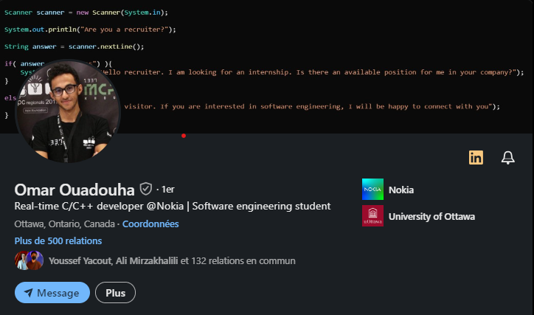
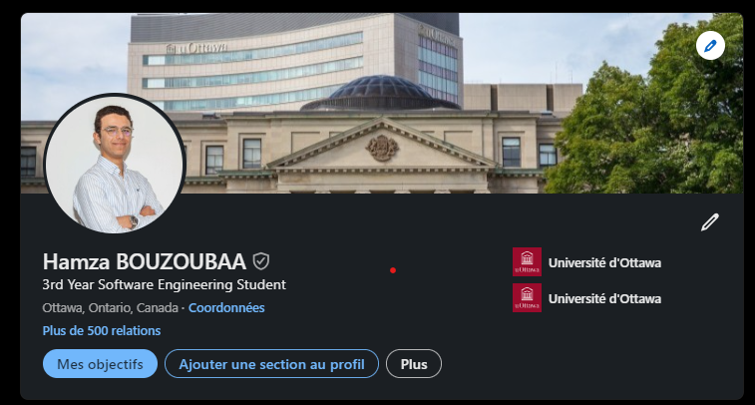
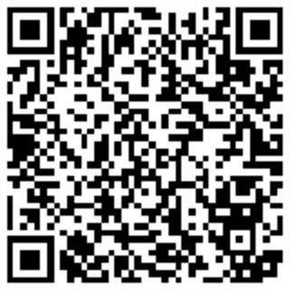
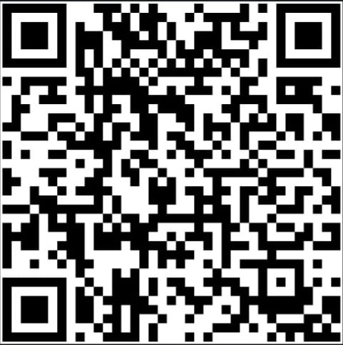
Let’s stay connected!

